Slide 1

Ziro Assembly Document
Prepared by Tanuj Siddharth
tanuj@zeroui.com

Slide 2
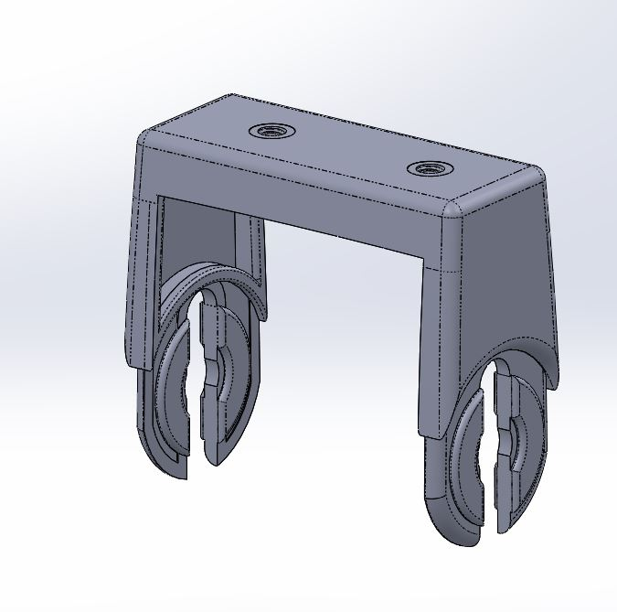

ZR2-MMD-HNG
Sub-Assembly
External
Internal
External Finish SPI C2 – 400 Grit
Internal Finish SPI C1/Non Expensive

Slide 3
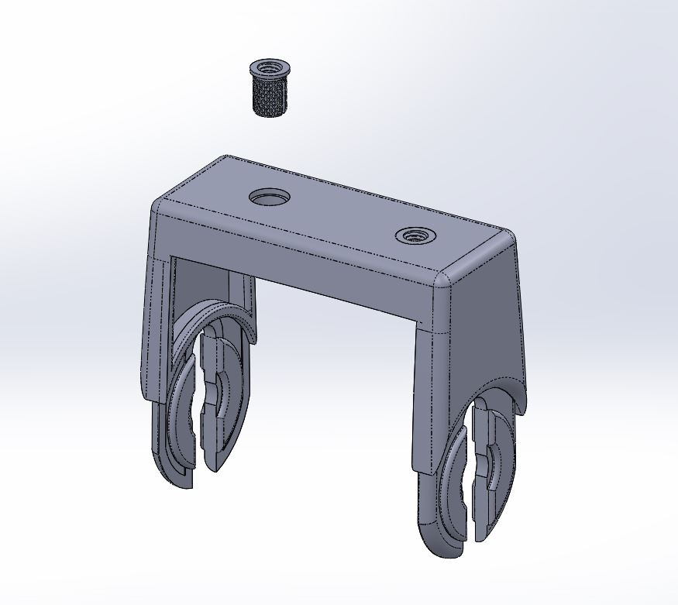
Sub -Assm # | Assm #
ZR2-MMD-HNG | ZR2-MMD-HNG-ASSM1
ZR2-MMD-RTP | ZR2-MMD-RTP-ASSM1
ZR2-MMD-RPS | ZR2-MMD-RPS-ASSM1
ZR2-MMD-QRK | ZR2-MMD-QRK-ASSM1
 | ZR2-MMD-QRK-ASSM2
 | ZR2-MMD-QRK-ASSM3
 | ZR2-MMD-QRK-ASSM4
 | ZR2-MMD-QRK-ASSM5
 | ZR2-MMD-QRK-ASSM6
 | ZR2-MMD-QRK-ASSM7
ZR2-MMD | ZR2-MMD-ASSM1
 | ZR2-MMD-ASSM2
 | ZR2-MMD-ASSM3
 | ZR2-MMD-ASSM4
 | ZR2-MMD-ASSM5
ZR2-PCK-TRA | ZR2-PCK-BOX-ASSM1
 | ZR2-PCK-BOX-ASSM2
ZR2-WHL | ZR2-WHL-ASSM1
ZR2-TLE-POD | ZR2-TLE-POD-ASSM1
ZR2-CSC | ZR2-MMD-RPS-ASSM1
Push Fit:
ZR2-MMD-HNG-PR1032 into ZR2-MMD-HNG-BODY
ZR2-MMD-HNG-PR1032
ZR2-MMD-HNG-PR1032
ZR2-MMD-HNG-BODY
External Finish SPI C2 – 400 Grit
Internal Finish SPI C1/Non Expensive

Slide 4
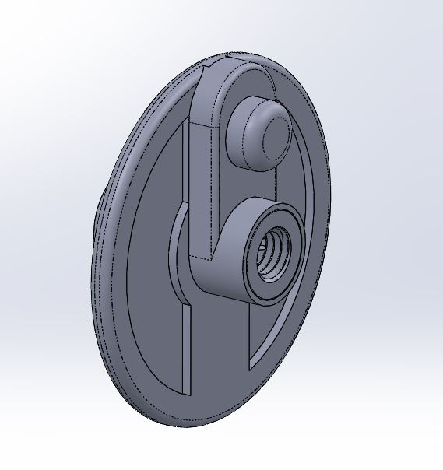
ZR2-MMD-RTP
Sub-Assembly
Overall Finish: SPI C2 – 400 Grit

Slide 5
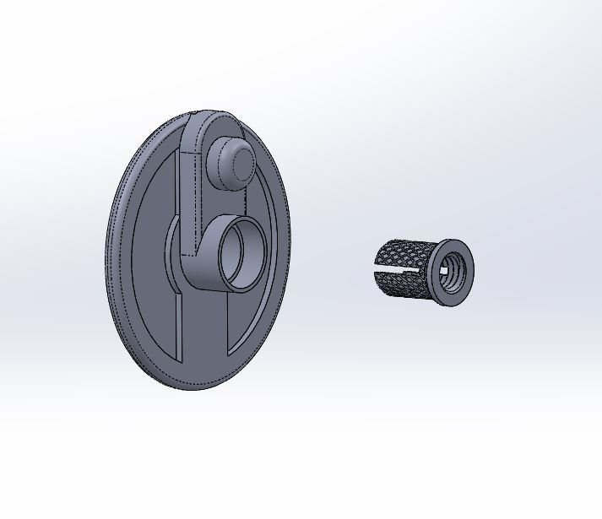
Sub -Assm # | Assm #
ZR2-MMD-HNG | ZR2-MMD-HNG-ASSM1
ZR2-MMD-RTP | ZR2-MMD-RTP-ASSM1
ZR2-MMD-RPS | ZR2-MMD-RPS-ASSM1
ZR2-MMD-QRK | ZR2-MMD-QRK-ASSM1
 | ZR2-MMD-QRK-ASSM2
 | ZR2-MMD-QRK-ASSM3
 | ZR2-MMD-QRK-ASSM4
 | ZR2-MMD-QRK-ASSM5
 | ZR2-MMD-QRK-ASSM6
 | ZR2-MMD-QRK-ASSM7
ZR2-MMD | ZR2-MMD-ASSM1
 | ZR2-MMD-ASSM2
 | ZR2-MMD-ASSM3
 | ZR2-MMD-ASSM4
 | ZR2-MMD-ASSM5
ZR2-PCK-TRA | ZR2-PCK-BOX-ASSM1
 | ZR2-PCK-BOX-ASSM2
ZR2-WHL | ZR2-WHL-ASSM1
ZR2-TLE-POD | ZR2-TLE-POD-ASSM1
ZR2-CSC | ZR2-MMD-RPS-ASSM1
Push Fit:
ZR2-MMD-RTP-PR1032 into ZR2-MMD-RTP-BODY
ZR2-MMD-RTP-PR1032
ZR2-MMD-RTP-BODY

Slide 6
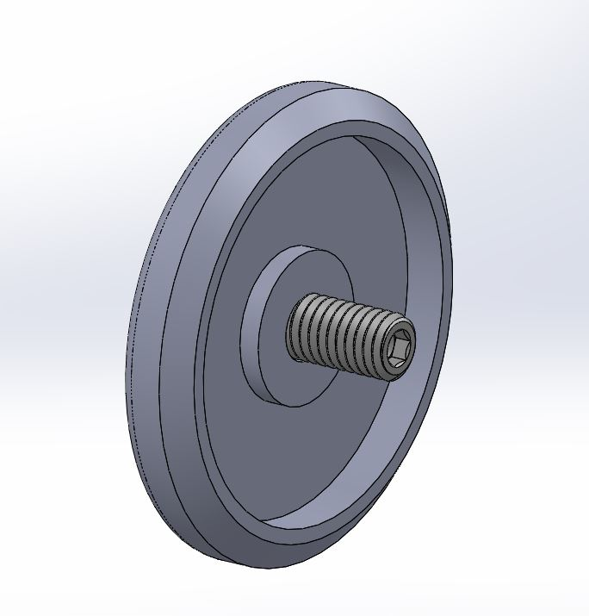
ZR2-MMD-RPS
Sub-Assembly
Overall Finish: SPI C2 – 400 Grit

Slide 7
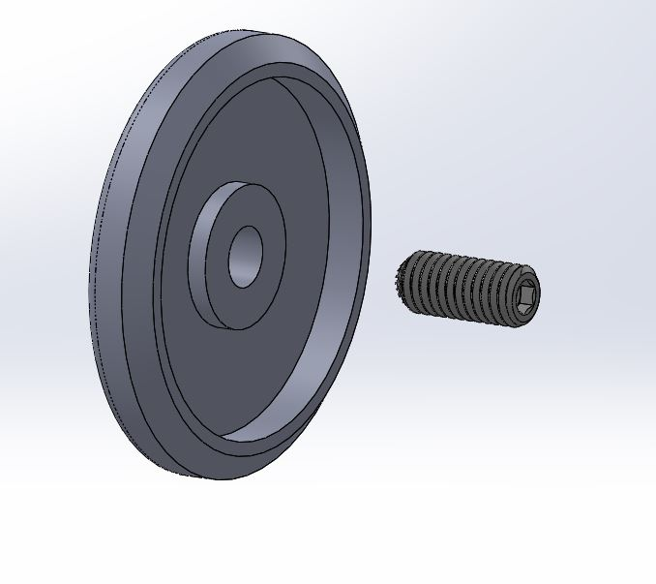
Sub -Assm # | Assm #
ZR2-MMD-HNG | ZR2-MMD-HNG-ASSM1
ZR2-MMD-RTP | ZR2-MMD-RTP-ASSM1
ZR2-MMD-RPS | ZR2-MMD-RPS-ASSM1
ZR2-MMD-QRK | ZR2-MMD-QRK-ASSM1
 | ZR2-MMD-QRK-ASSM2
 | ZR2-MMD-QRK-ASSM3
 | ZR2-MMD-QRK-ASSM4
 | ZR2-MMD-QRK-ASSM5
 | ZR2-MMD-QRK-ASSM6
 | ZR2-MMD-QRK-ASSM7
ZR2-MMD | ZR2-MMD-ASSM1
 | ZR2-MMD-ASSM2
 | ZR2-MMD-ASSM3
 | ZR2-MMD-ASSM4
 | ZR2-MMD-ASSM5
ZR2-PCK-TRA | ZR2-PCK-BOX-ASSM1
 | ZR2-PCK-BOX-ASSM2
ZR2-WHL | ZR2-WHL-ASSM1
ZR2-TLE-POD | ZR2-TLE-POD-ASSM1
ZR2-CSC | ZR2-MMD-RPS-ASSM1
Screw Fit:
ZR2-MMD-RPS-F1032 into ZR2-MMD-RPS-BODY
ZR2-MMD-RPS-F1032
ZR2-MMD-RPS-BODY

Slide 8
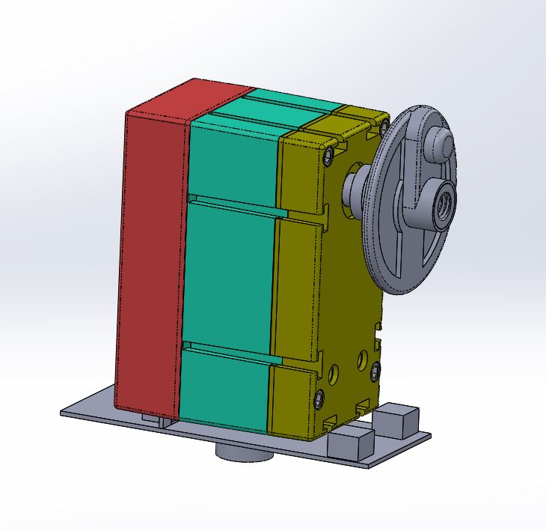
ZR2-MMD-QRK
Sub-Assembly
Overall Finish: SPI C3 OR LOWER FOR CASINGS

Slide 9
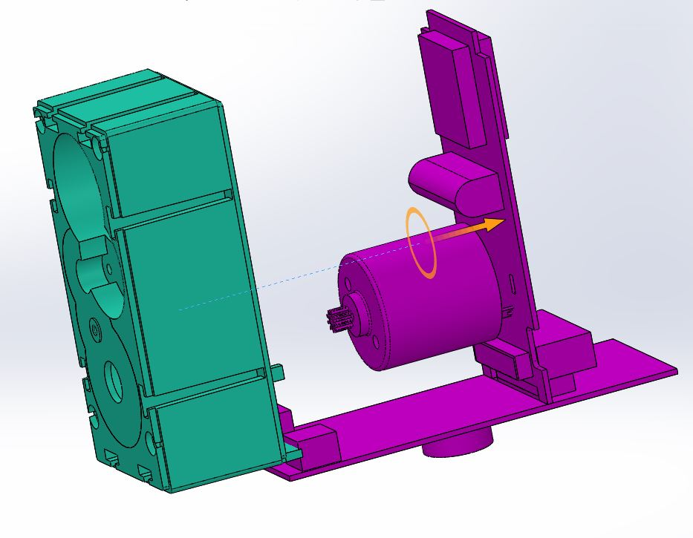
Sub -Assm # | Assm #
ZR2-MMD-HNG | ZR2-MMD-HNG-ASSM1
ZR2-MMD-RTP | ZR2-MMD-RTP-ASSM1
ZR2-MMD-RPS | ZR2-MMD-RPS-ASSM1
ZR2-MMD-QRK | ZR2-MMD-QRK-ASSM1
 | ZR2-MMD-QRK-ASSM2
 | ZR2-MMD-QRK-ASSM3
 | ZR2-MMD-QRK-ASSM4
 | ZR2-MMD-QRK-ASSM5
 | ZR2-MMD-QRK-ASSM6
 | ZR2-MMD-QRK-ASSM7
ZR2-MMD | ZR2-MMD-ASSM1
 | ZR2-MMD-ASSM2
 | ZR2-MMD-ASSM3
 | ZR2-MMD-ASSM4
 | ZR2-MMD-ASSM5
ZR2-PCK-TRA | ZR2-PCK-BOX-ASSM1
 | ZR2-PCK-BOX-ASSM2
ZR2-WHL | ZR2-WHL-ASSM1
ZR2-TLE-POD | ZR2-TLE-POD-ASSM1
ZR2-CSC | ZR2-MMD-RPS-ASSM1
Insert:
Slide Motor and PCB assembly into Quark housing i.e.ZR2-MMD-QRK-E1-ASSM3 into ZR2-MMD-QRK-M-CMD
ZR2-MMD-QRK-E1-ASSM3
ZR2-MMD-QRK-M-CMD

Slide 10
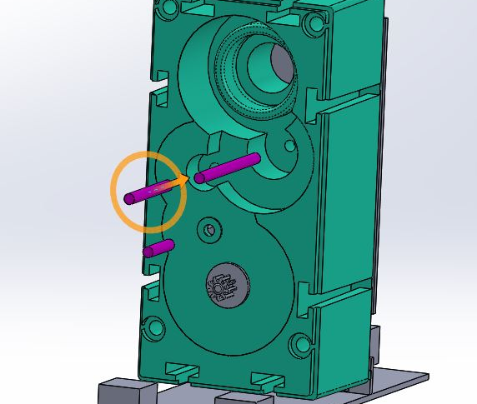
Sub -Assm # | Assm #
ZR2-MMD-HNG | ZR2-MMD-HNG-ASSM1
ZR2-MMD-RTP | ZR2-MMD-RTP-ASSM1
ZR2-MMD-RPS | ZR2-MMD-RPS-ASSM1
ZR2-MMD-QRK | ZR2-MMD-QRK-ASSM1
 | ZR2-MMD-QRK-ASSM2
 | ZR2-MMD-QRK-ASSM3
 | ZR2-MMD-QRK-ASSM4
 | ZR2-MMD-QRK-ASSM5
 | ZR2-MMD-QRK-ASSM6
 | ZR2-MMD-QRK-ASSM7
ZR2-MMD | ZR2-MMD-ASSM1
 | ZR2-MMD-ASSM2
 | ZR2-MMD-ASSM3
 | ZR2-MMD-ASSM4
 | ZR2-MMD-ASSM5
ZR2-PCK-TRA | ZR2-PCK-BOX-ASSM1
 | ZR2-PCK-BOX-ASSM2
ZR2-WHL | ZR2-WHL-ASSM1
ZR2-TLE-POD | ZR2-TLE-POD-ASSM1
ZR2-CSC | ZR2-MMD-RPS-ASSM1
Insert:
Put 3 shafts ZR2-MMD-QRK-M-(SFT150-725-G2, SFT150-1300-G3, SFT150-1900-G4), into ZR2-MMD-QRK-M-CMD
ZR2-MMD-QRK-M-SFT150-1900-G4
ZR2-MMD-QRK-M-SFT150-1300-G3
ZR2-MMD-QRK-M-SFT150-725-G2
ZR2-MMD-QRK-M-CMD

Slide 11
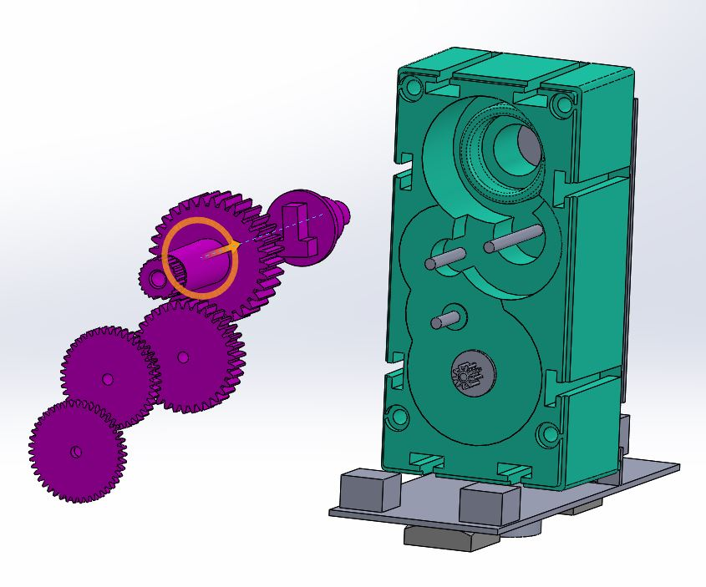
Sub -Assm # | Assm #
ZR2-MMD-HNG | ZR2-MMD-HNG-ASSM1
ZR2-MMD-RTP | ZR2-MMD-RTP-ASSM1
ZR2-MMD-RPS | ZR2-MMD-RPS-ASSM1
ZR2-MMD-QRK | ZR2-MMD-QRK-ASSM1
 | ZR2-MMD-QRK-ASSM2
 | ZR2-MMD-QRK-ASSM3
 | ZR2-MMD-QRK-ASSM4
 | ZR2-MMD-QRK-ASSM5
 | ZR2-MMD-QRK-ASSM6
 | ZR2-MMD-QRK-ASSM7
ZR2-MMD | ZR2-MMD-ASSM1
 | ZR2-MMD-ASSM2
 | ZR2-MMD-ASSM3
 | ZR2-MMD-ASSM4
 | ZR2-MMD-ASSM5
ZR2-PCK-TRA | ZR2-PCK-BOX-ASSM1
 | ZR2-PCK-BOX-ASSM2
ZR2-WHL | ZR2-WHL-ASSM1
ZR2-TLE-POD | ZR2-TLE-POD-ASSM1
ZR2-CSC | ZR2-MMD-RPS-ASSM1
Insert: Five Plastic Gears ZR2-MMD-QRK-M-(GPC,G5,G4,G3,G2) onto above placed shafts. Order: (GPC,G5,G4,G3,G2)
ZR2-MMD-QRK-M-G5
ZR2-MMD-QRK-M-GPC
ZR2-MMD-QRK-M-G3
ZR2-MMD-QRK-M-G4
ZR2-MMD-QRK-M-G2
ZR2-MMD-QRK-M-CMD

Slide 12
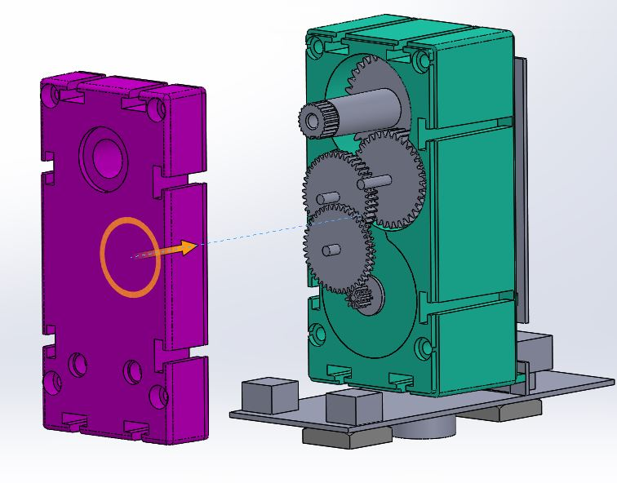
Sub -Assm # | Assm #
ZR2-MMD-HNG | ZR2-MMD-HNG-ASSM1
ZR2-MMD-RTP | ZR2-MMD-RTP-ASSM1
ZR2-MMD-RPS | ZR2-MMD-RPS-ASSM1
ZR2-MMD-QRK | ZR2-MMD-QRK-ASSM1
 | ZR2-MMD-QRK-ASSM2
 | ZR2-MMD-QRK-ASSM3
 | ZR2-MMD-QRK-ASSM4
 | ZR2-MMD-QRK-ASSM5
 | ZR2-MMD-QRK-ASSM6
 | ZR2-MMD-QRK-ASSM7
ZR2-MMD | ZR2-MMD-ASSM1
 | ZR2-MMD-ASSM2
 | ZR2-MMD-ASSM3
 | ZR2-MMD-ASSM4
 | ZR2-MMD-ASSM5
ZR2-PCK-TRA | ZR2-PCK-BOX-ASSM1
 | ZR2-PCK-BOX-ASSM2
ZR2-WHL | ZR2-WHL-ASSM1
ZR2-TLE-POD | ZR2-TLE-POD-ASSM1
ZR2-CSC | ZR2-MMD-RPS-ASSM1
Cover:
Put the lid ZR2-MMD-QRK-M-CTP
ZR2-MMD-QRK-M-CTP
ZR2-MMD-QRK-M-CMD

Slide 13
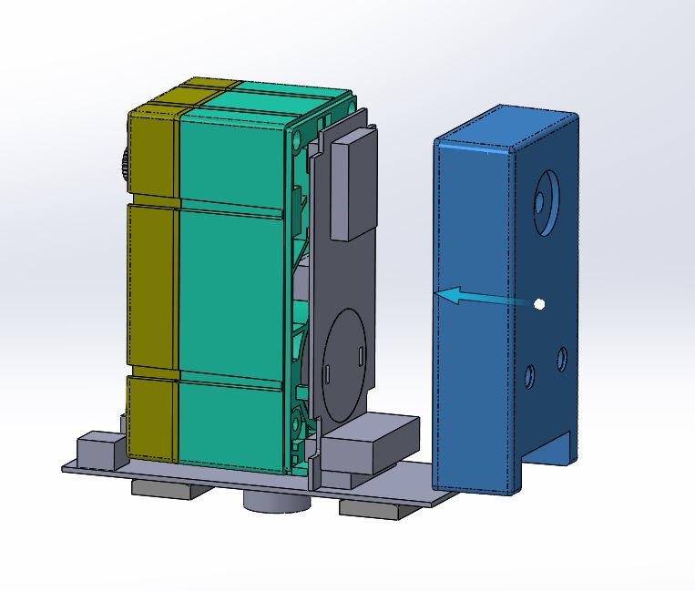
Sub -Assm # | Assm #
ZR2-MMD-HNG | ZR2-MMD-HNG-ASSM1
ZR2-MMD-RTP | ZR2-MMD-RTP-ASSM1
ZR2-MMD-RPS | ZR2-MMD-RPS-ASSM1
ZR2-MMD-QRK | ZR2-MMD-QRK-ASSM1
 | ZR2-MMD-QRK-ASSM2
 | ZR2-MMD-QRK-ASSM3
 | ZR2-MMD-QRK-ASSM4
 | ZR2-MMD-QRK-ASSM5
 | ZR2-MMD-QRK-ASSM6
 | ZR2-MMD-QRK-ASSM7
ZR2-MMD | ZR2-MMD-ASSM1
 | ZR2-MMD-ASSM2
 | ZR2-MMD-ASSM3
 | ZR2-MMD-ASSM4
 | ZR2-MMD-ASSM5
ZR2-PCK-TRA | ZR2-PCK-BOX-ASSM1
 | ZR2-PCK-BOX-ASSM2
ZR2-WHL | ZR2-WHL-ASSM1
ZR2-TLE-POD | ZR2-TLE-POD-ASSM1
ZR2-CSC | ZR2-MMD-RPS-ASSM1
Cover:
Put the lid ZR2-MMD-QRK-M-CBM
ZR2-MMD-QRK-M-CBM
ZR2-MMD-QRK-M-CMD

Slide 14
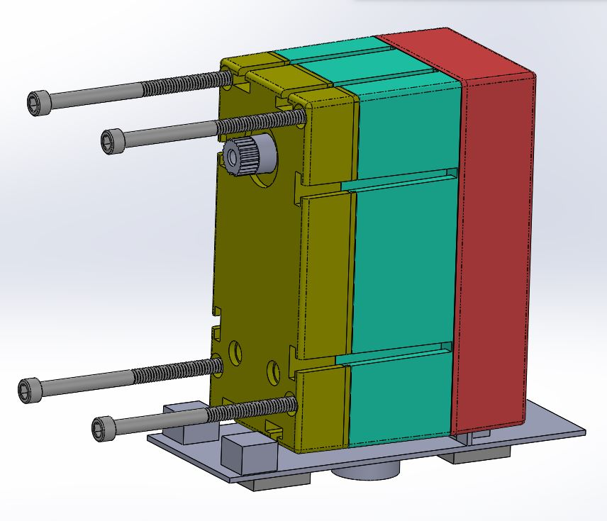
Sub -Assm # | Assm #
ZR2-MMD-HNG | ZR2-MMD-HNG-ASSM1
ZR2-MMD-RTP | ZR2-MMD-RTP-ASSM1
ZR2-MMD-RPS | ZR2-MMD-RPS-ASSM1
ZR2-MMD-QRK | ZR2-MMD-QRK-ASSM1
 | ZR2-MMD-QRK-ASSM2
 | ZR2-MMD-QRK-ASSM3
 | ZR2-MMD-QRK-ASSM4
 | ZR2-MMD-QRK-ASSM5
 | ZR2-MMD-QRK-ASSM6
 | ZR2-MMD-QRK-ASSM7
ZR2-MMD | ZR2-MMD-ASSM1
 | ZR2-MMD-ASSM2
 | ZR2-MMD-ASSM3
 | ZR2-MMD-ASSM4
 | ZR2-MMD-ASSM5
ZR2-PCK-TRA | ZR2-PCK-BOX-ASSM1
 | ZR2-PCK-BOX-ASSM2
ZR2-WHL | ZR2-WHL-ASSM1
ZR2-TLE-POD | ZR2-TLE-POD-ASSM1
ZR2-CSC | ZR2-MMD-RPS-ASSM1
Screw:
Screw 4 ZR2-MMD-QRK-M-SCR-18-8 into top lid
ZR2-MMD-QRK-M-SCR-18-8
ZR2-MMD-QRK-M-CTP

Slide 15
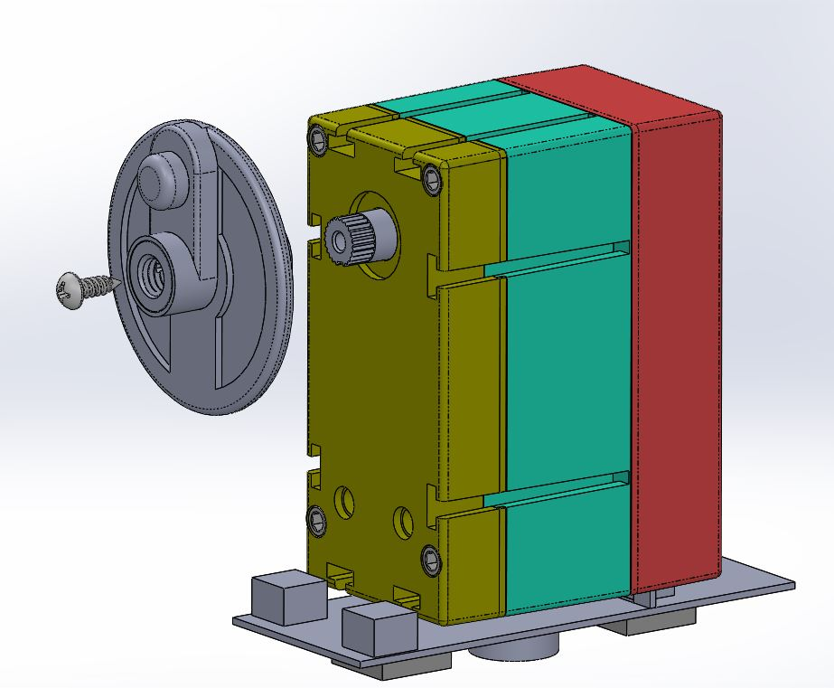
Sub -Assm # | Assm #
ZR2-MMD-HNG | ZR2-MMD-HNG-ASSM1
ZR2-MMD-RTP | ZR2-MMD-RTP-ASSM1
ZR2-MMD-RPS | ZR2-MMD-RPS-ASSM1
ZR2-MMD-QRK | ZR2-MMD-QRK-ASSM1
 | ZR2-MMD-QRK-ASSM2
 | ZR2-MMD-QRK-ASSM3
 | ZR2-MMD-QRK-ASSM4
 | ZR2-MMD-QRK-ASSM5
 | ZR2-MMD-QRK-ASSM6
 | ZR2-MMD-QRK-ASSM7
ZR2-MMD | ZR2-MMD-ASSM1
 | ZR2-MMD-ASSM2
 | ZR2-MMD-ASSM3
 | ZR2-MMD-ASSM4
 | ZR2-MMD-ASSM5
ZR2-PCK-TRA | ZR2-PCK-BOX-ASSM1
 | ZR2-PCK-BOX-ASSM2
ZR2-WHL | ZR2-WHL-ASSM1
ZR2-TLE-POD | ZR2-TLE-POD-ASSM1
ZR2-CSC | ZR2-MMD-RPS-ASSM1
Insert: Align the spline and insert ZR2-MMD-RTP-ASSM1 over ZR2-MMD-QRK-M-G5 and screw using ZR2-MMD-QRK-M-SCR-M2.2X6mm
ZR2-MMD-RTP-ASSM1
ZR2-MMD-QRK-M-SCR-M2.2X6mm
ZR2-MMD-QRK-M-G5

Slide 16
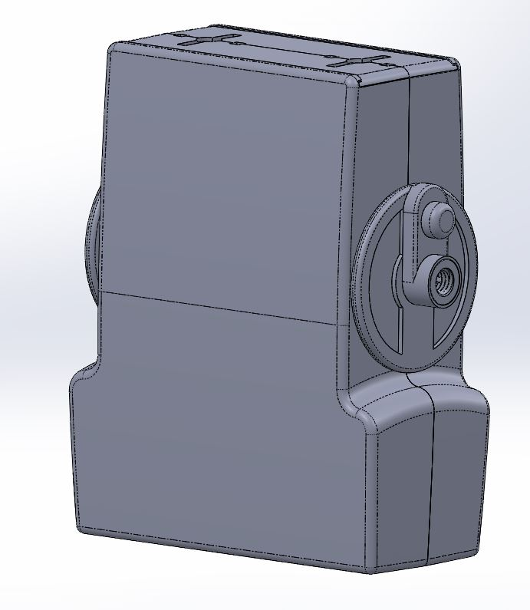
ZR2-MMD
Main Assembly
External Finish SPI C2 – 400 Grit
Internal Finish SPI C1/Non Expensive

Slide 17
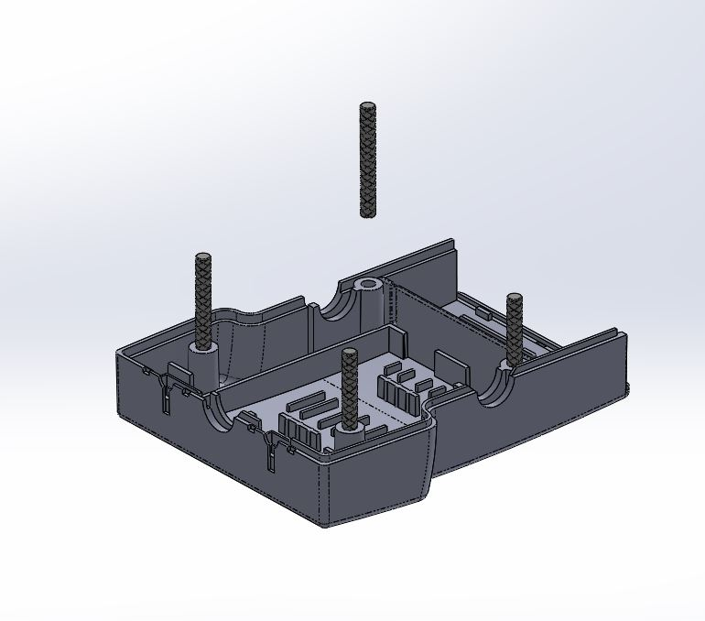
Sub -Assm # | Assm #
ZR2-MMD-HNG | ZR2-MMD-HNG-ASSM1
ZR2-MMD-RTP | ZR2-MMD-RTP-ASSM1
ZR2-MMD-RPS | ZR2-MMD-RPS-ASSM1
ZR2-MMD-QRK | ZR2-MMD-QRK-ASSM1
 | ZR2-MMD-QRK-ASSM2
 | ZR2-MMD-QRK-ASSM3
 | ZR2-MMD-QRK-ASSM4
 | ZR2-MMD-QRK-ASSM5
 | ZR2-MMD-QRK-ASSM6
 | ZR2-MMD-QRK-ASSM7
ZR2-MMD | ZR2-MMD-ASSM1
 | ZR2-MMD-ASSM2
 | ZR2-MMD-ASSM3
 | ZR2-MMD-ASSM4
 | ZR2-MMD-ASSM5
ZR2-PCK-TRA | ZR2-PCK-BOX-ASSM1
 | ZR2-PCK-BOX-ASSM2
ZR2-WHL | ZR2-WHL-ASSM1
ZR2-TLE-POD | ZR2-TLE-POD-ASSM1
ZR2-CSC | ZR2-MMD-RPS-ASSM1
Insert :
Insert ZR2-MMD-SHL-KNSHFT to the holes of the knurled shafts in the shell ZR2-MMD-SHL-BODY
ZR2-MMD-SHL-KNSHFT X 4
ZR2-MMD-SHL-BODY

Slide 18
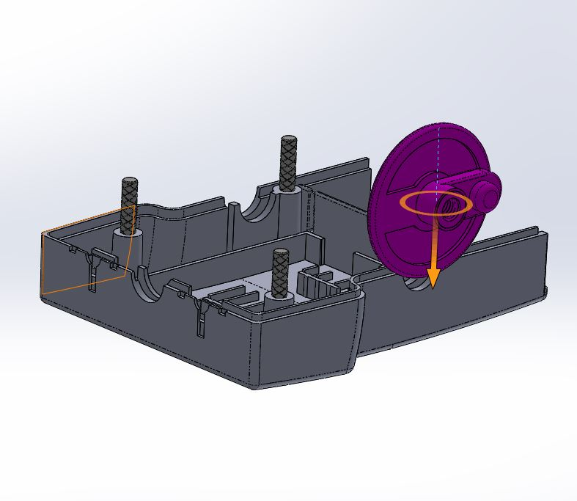
Sub -Assm # | Assm #
ZR2-MMD-HNG | ZR2-MMD-HNG-ASSM1
ZR2-MMD-RTP | ZR2-MMD-RTP-ASSM1
ZR2-MMD-RPS | ZR2-MMD-RPS-ASSM1
ZR2-MMD-QRK | ZR2-MMD-QRK-ASSM1
 | ZR2-MMD-QRK-ASSM2
 | ZR2-MMD-QRK-ASSM3
 | ZR2-MMD-QRK-ASSM4
 | ZR2-MMD-QRK-ASSM5
 | ZR2-MMD-QRK-ASSM6
 | ZR2-MMD-QRK-ASSM7
ZR2-MMD | ZR2-MMD-ASSM1
 | ZR2-MMD-ASSM2
 | ZR2-MMD-ASSM3
 | ZR2-MMD-ASSM4
 | ZR2-MMD-ASSM5
ZR2-PCK-TRA | ZR2-PCK-BOX-ASSM1
 | ZR2-PCK-BOX-ASSM2
ZR2-WHL | ZR2-WHL-ASSM1
ZR2-TLE-POD | ZR2-TLE-POD-ASSM1
ZR2-CSC | ZR2-MMD-RPS-ASSM1
Insert:
ZR2-MMD-RTP-ASSM1 in ZR2-MMD-ASSM1 on the opposite side of the quark.
ZR2-MMD-RTP-ASSM1
ZR2-MMD-ASSM1

Slide 19
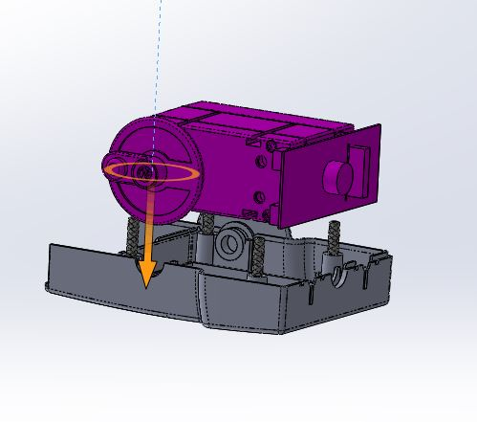
Sub -Assm # | Assm #
ZR2-MMD-HNG | ZR2-MMD-HNG-ASSM1
ZR2-MMD-RTP | ZR2-MMD-RTP-ASSM1
ZR2-MMD-RPS | ZR2-MMD-RPS-ASSM1
ZR2-MMD-QRK | ZR2-MMD-QRK-ASSM1
 | ZR2-MMD-QRK-ASSM2
 | ZR2-MMD-QRK-ASSM3
 | ZR2-MMD-QRK-ASSM4
 | ZR2-MMD-QRK-ASSM5
 | ZR2-MMD-QRK-ASSM6
 | ZR2-MMD-QRK-ASSM7
ZR2-MMD | ZR2-MMD-ASSM1
 | ZR2-MMD-ASSM2
 | ZR2-MMD-ASSM3
 | ZR2-MMD-ASSM4
 | ZR2-MMD-ASSM5
ZR2-PCK-TRA | ZR2-PCK-BOX-ASSM1
 | ZR2-PCK-BOX-ASSM2
ZR2-WHL | ZR2-WHL-ASSM1
ZR2-TLE-POD | ZR2-TLE-POD-ASSM1
ZR2-CSC | ZR2-MMD-RPS-ASSM1
Insert:
Insert Quark with PCB (finished in the process
ZR2-MMD-QRK-ASSM6) into ZR2-MMD-SHL-BODY
ZR2-MMD-QRK-ASSM7
ZR2-MMD-ASSM2
Note: PCB is not dimensioned exactly

Slide 20
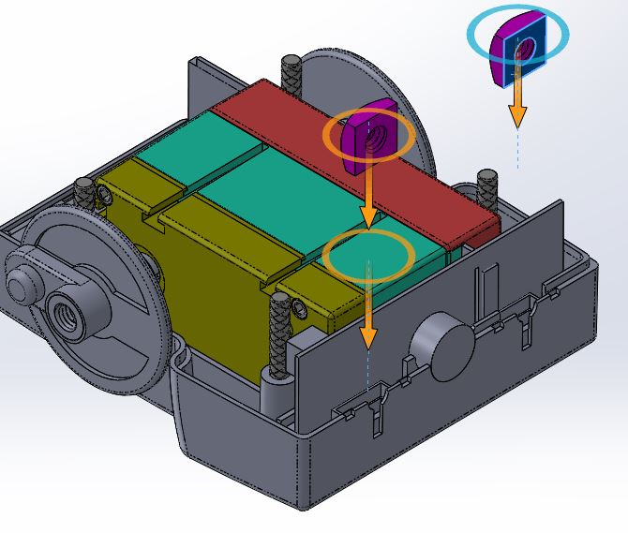
Sub -Assm # | Assm #
ZR2-MMD-HNG | ZR2-MMD-HNG-ASSM1
ZR2-MMD-RTP | ZR2-MMD-RTP-ASSM1
ZR2-MMD-RPS | ZR2-MMD-RPS-ASSM1
ZR2-MMD-QRK | ZR2-MMD-QRK-ASSM1
 | ZR2-MMD-QRK-ASSM2
 | ZR2-MMD-QRK-ASSM3
 | ZR2-MMD-QRK-ASSM4
 | ZR2-MMD-QRK-ASSM5
 | ZR2-MMD-QRK-ASSM6
 | ZR2-MMD-QRK-ASSM7
ZR2-MMD | ZR2-MMD-ASSM1
 | ZR2-MMD-ASSM2
 | ZR2-MMD-ASSM3
 | ZR2-MMD-ASSM4
 | ZR2-MMD-ASSM5
ZR2-PCK-TRA | ZR2-PCK-BOX-ASSM1
 | ZR2-PCK-BOX-ASSM2
ZR2-WHL | ZR2-WHL-ASSM1
ZR2-TLE-POD | ZR2-TLE-POD-ASSM1
ZR2-CSC | ZR2-MMD-RPS-ASSM1
Insert:
Square Nuts ZR2-MMD-SHL-SQN into the
ZR2-MMD-SHL-BODY
ZR2-MMD-SHL-SQN X 2
ZR2-MMD-SHL-BODY

Slide 21
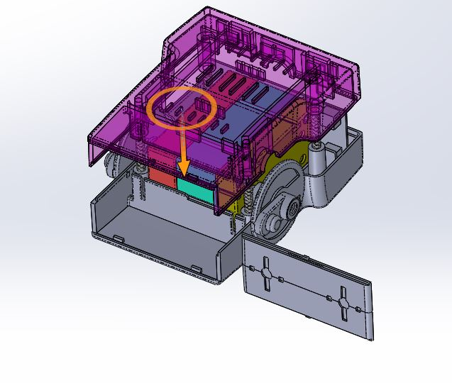
Sub -Assm # | Assm #
ZR2-MMD-HNG | ZR2-MMD-HNG-ASSM1
ZR2-MMD-RTP | ZR2-MMD-RTP-ASSM1
ZR2-MMD-RPS | ZR2-MMD-RPS-ASSM1
ZR2-MMD-QRK | ZR2-MMD-QRK-ASSM1
 | ZR2-MMD-QRK-ASSM2
 | ZR2-MMD-QRK-ASSM3
 | ZR2-MMD-QRK-ASSM4
 | ZR2-MMD-QRK-ASSM5
 | ZR2-MMD-QRK-ASSM6
 | ZR2-MMD-QRK-ASSM7
ZR2-MMD | ZR2-MMD-ASSM1
 | ZR2-MMD-ASSM2
 | ZR2-MMD-ASSM3
 | ZR2-MMD-ASSM4
 | ZR2-MMD-ASSM5
ZR2-PCK-TRA | ZR2-PCK-BOX-ASSM1
 | ZR2-PCK-BOX-ASSM2
ZR2-WHL | ZR2-WHL-ASSM1
ZR2-TLE-POD | ZR2-TLE-POD-ASSM1
ZR2-CSC | ZR2-MMD-RPS-ASSM1
Push Fit:
Push shell (ZR2-MMD-SHL-BODY) onto above assembly and slide the battery Lid ZR2-MMD-SHL-BLID in position
ZR2-MMD-SHL-BODY
ZR2-MMD-SHL-BLID

Slide 22
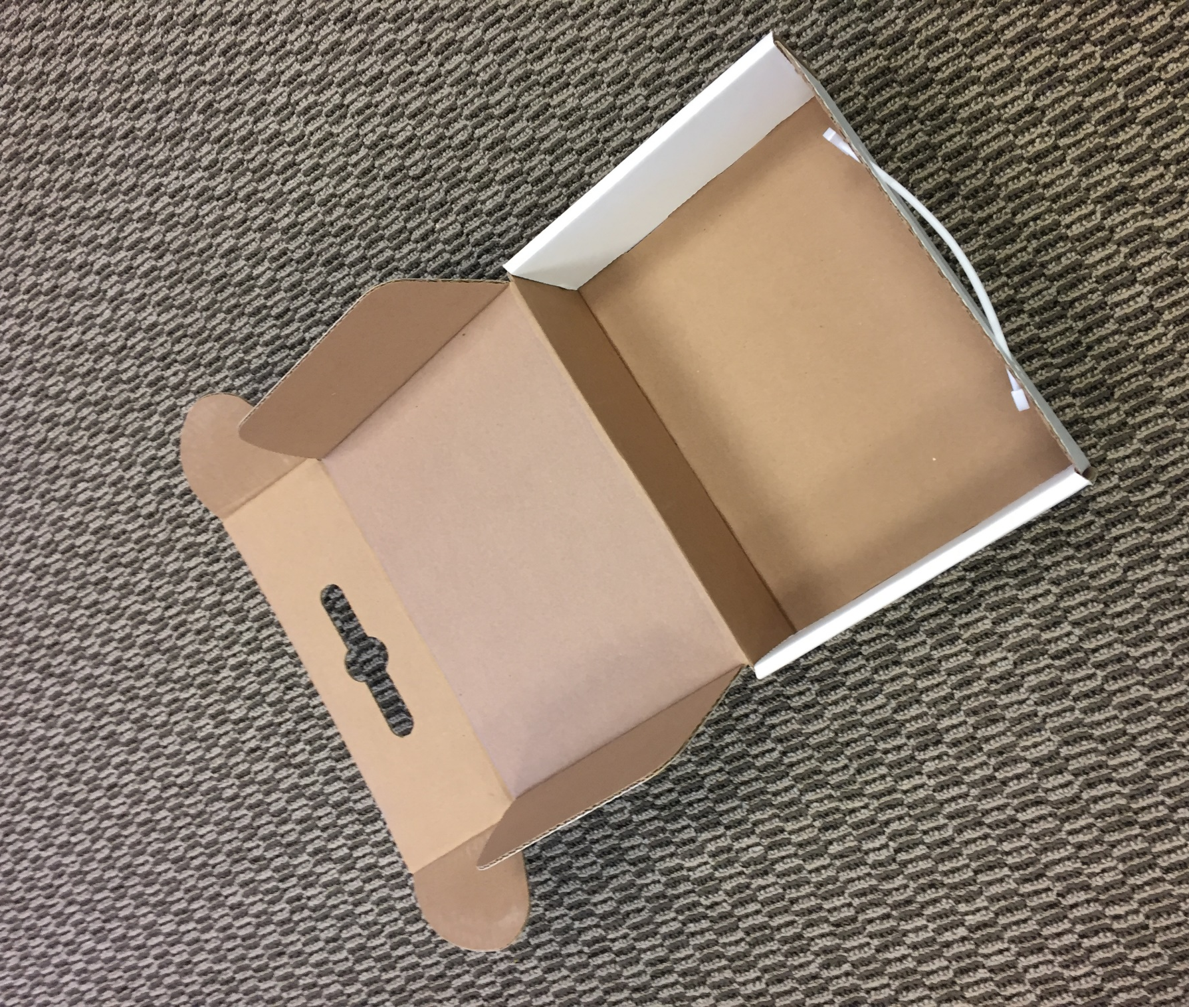
Sub -Assm # | Assm #
ZR2-MMD-HNG | ZR2-MMD-HNG-ASSM1
ZR2-MMD-RTP | ZR2-MMD-RTP-ASSM1
ZR2-MMD-RPS | ZR2-MMD-RPS-ASSM1
ZR2-MMD-QRK | ZR2-MMD-QRK-ASSM1
 | ZR2-MMD-QRK-ASSM2
 | ZR2-MMD-QRK-ASSM3
 | ZR2-MMD-QRK-ASSM4
 | ZR2-MMD-QRK-ASSM5
 | ZR2-MMD-QRK-ASSM6
 | ZR2-MMD-QRK-ASSM7
ZR2-MMD | ZR2-MMD-ASSM1
 | ZR2-MMD-ASSM2
 | ZR2-MMD-ASSM3
 | ZR2-MMD-ASSM4
 | ZR2-MMD-ASSM5
ZR2-PCK-TRA | ZR2-PCK-BOX-ASSM1
 | ZR2-PCK-BOX-ASSM2
ZR2-WHL | ZR2-WHL-ASSM1
ZR2-TLE-POD | ZR2-TLE-POD-ASSM1
ZR2-CSC | ZR2-MMD-RPS-ASSM1
Fold
Fold cardboard into final shape i.e.
ZR2-PCK-BOX-CBD into box shape
ZR2-PCK-BOX-CBD

Slide 23
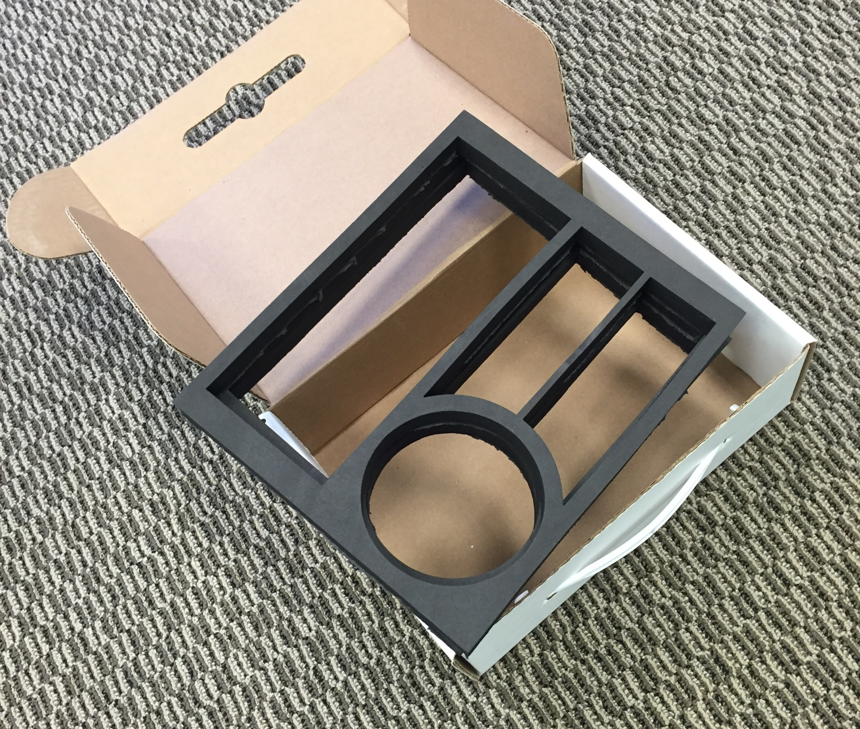
Sub -Assm # | Assm #
ZR2-MMD-HNG | ZR2-MMD-HNG-ASSM1
ZR2-MMD-RTP | ZR2-MMD-RTP-ASSM1
ZR2-MMD-RPS | ZR2-MMD-RPS-ASSM1
ZR2-MMD-QRK | ZR2-MMD-QRK-ASSM1
 | ZR2-MMD-QRK-ASSM2
 | ZR2-MMD-QRK-ASSM3
 | ZR2-MMD-QRK-ASSM4
 | ZR2-MMD-QRK-ASSM5
 | ZR2-MMD-QRK-ASSM6
 | ZR2-MMD-QRK-ASSM7
ZR2-MMD | ZR2-MMD-ASSM1
 | ZR2-MMD-ASSM2
 | ZR2-MMD-ASSM3
 | ZR2-MMD-ASSM4
 | ZR2-MMD-ASSM5
ZR2-PCK-TRA | ZR2-PCK-BOX-ASSM1
 | ZR2-PCK-BOX-ASSM2
ZR2-WHL | ZR2-WHL-ASSM1
ZR2-TLE-POD | ZR2-TLE-POD-ASSM1
ZR2-CSC | ZR2-MMD-RPS-ASSM1
Place
Place Foam into box:
ZR2-PCK-LFM and UFM into ZR2-PCK-BOX
ZR2-PCK-BOX
ZR2-PCK-LFM and UFM

Slide 24
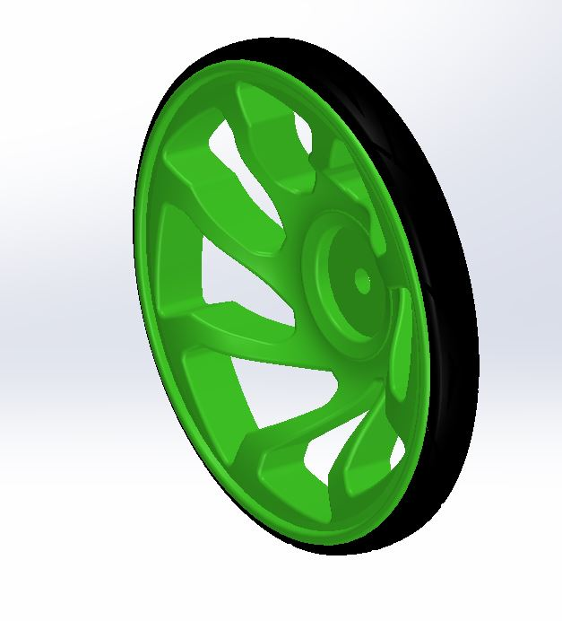
ZR2-WHL
Main Assembly
Overall Finish: SPI C1

Slide 25
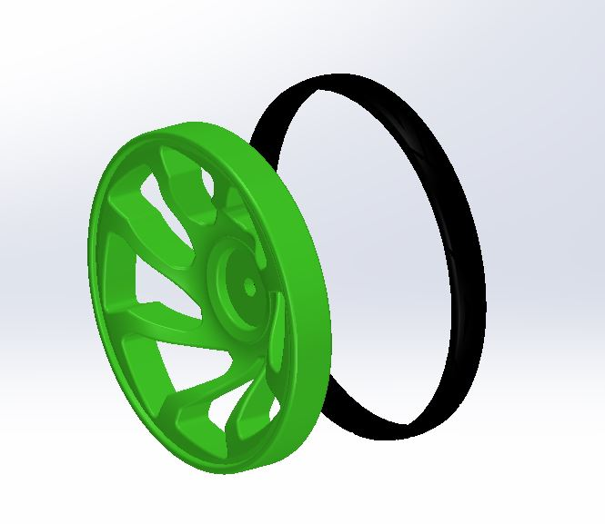
Sub -Assm # | Assm #
ZR2-MMD-HNG | ZR2-MMD-HNG-ASSM1
ZR2-MMD-RTP | ZR2-MMD-RTP-ASSM1
ZR2-MMD-RPS | ZR2-MMD-RPS-ASSM1
ZR2-MMD-QRK | ZR2-MMD-QRK-ASSM1
 | ZR2-MMD-QRK-ASSM2
 | ZR2-MMD-QRK-ASSM3
 | ZR2-MMD-QRK-ASSM4
 | ZR2-MMD-QRK-ASSM5
 | ZR2-MMD-QRK-ASSM6
 | ZR2-MMD-QRK-ASSM7
ZR2-MMD | ZR2-MMD-ASSM1
 | ZR2-MMD-ASSM2
 | ZR2-MMD-ASSM3
 | ZR2-MMD-ASSM4
 | ZR2-MMD-ASSM5
ZR2-PCK-TRA | ZR2-PCK-BOX-ASSM1
 | ZR2-PCK-BOX-ASSM2
ZR2-WHL | ZR2-WHL-ASSM1
ZR2-TLE-POD | ZR2-TLE-POD-ASSM1
ZR2-CSC | ZR2-MMD-RPS-ASSM1
Insert
Put tire over wheel rim i.e.
ZR2-WHL-TYRE onto ZR2-WHL-BODY
ZR2-WHL-TYRE
ZR2-WHL-BODY

Slide 26
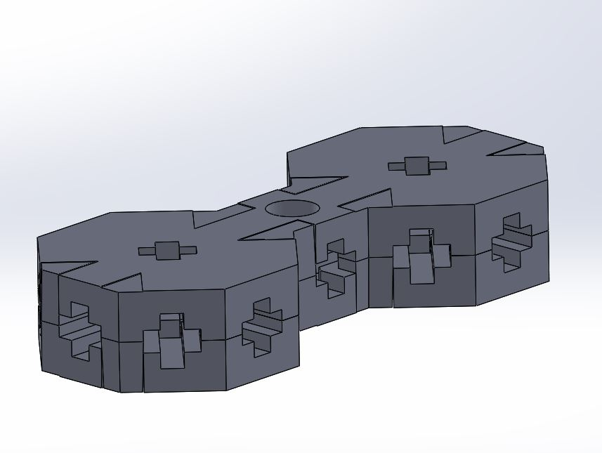
ZR2-TLE-POD
Sub-Assembly
Overall Finish: SPI C2 – 400 Grit

Slide 27
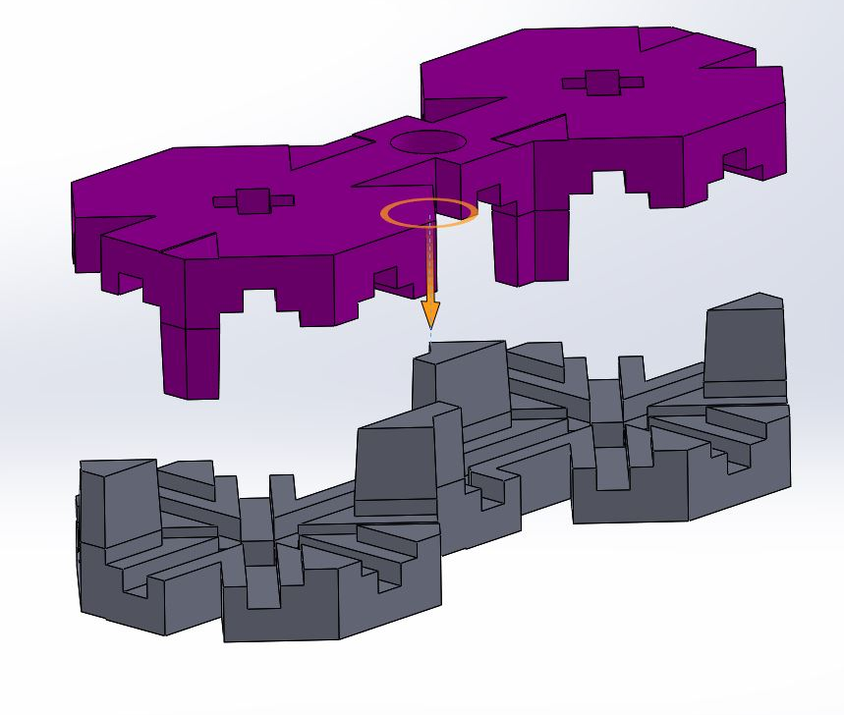
Sub -Assm # | Assm #
ZR2-MMD-HNG | ZR2-MMD-HNG-ASSM1
ZR2-MMD-RTP | ZR2-MMD-RTP-ASSM1
ZR2-MMD-RPS | ZR2-MMD-RPS-ASSM1
ZR2-MMD-QRK | ZR2-MMD-QRK-ASSM1
 | ZR2-MMD-QRK-ASSM2
 | ZR2-MMD-QRK-ASSM3
 | ZR2-MMD-QRK-ASSM4
 | ZR2-MMD-QRK-ASSM5
 | ZR2-MMD-QRK-ASSM6
 | ZR2-MMD-QRK-ASSM7
ZR2-MMD | ZR2-MMD-ASSM1
 | ZR2-MMD-ASSM2
 | ZR2-MMD-ASSM3
 | ZR2-MMD-ASSM4
 | ZR2-MMD-ASSM5
ZR2-PCK-TRA | ZR2-PCK-BOX-ASSM1
 | ZR2-PCK-BOX-ASSM2
ZR2-WHL | ZR2-WHL-ASSM1
ZR2-TLE-POD | ZR2-TLE-POD-ASSM1
ZR2-CSC | ZR2-MMD-RPS-ASSM1
Snap On:
Snap two ZR2-TLE-POD-BODY together
ZR2-TLE-POD-BODY
ZR2-TLE-POD-BODY

Slide 28
ZR2-CSC
Main Assembly
Overall Finish: SPI C2 – 400 Grit

Slide 29
Sub -Assm # | Assm #
ZR2-MMD-HNG | ZR2-MMD-HNG-ASSM1
ZR2-MMD-RTP | ZR2-MMD-RTP-ASSM1
ZR2-MMD-RPS | ZR2-MMD-RPS-ASSM1
ZR2-MMD-QRK | ZR2-MMD-QRK-ASSM1
 | ZR2-MMD-QRK-ASSM2
 | ZR2-MMD-QRK-ASSM3
 | ZR2-MMD-QRK-ASSM4
 | ZR2-MMD-QRK-ASSM5
 | ZR2-MMD-QRK-ASSM6
 | ZR2-MMD-QRK-ASSM7
ZR2-MMD | ZR2-MMD-ASSM1
 | ZR2-MMD-ASSM2
 | ZR2-MMD-ASSM3
 | ZR2-MMD-ASSM4
 | ZR2-MMD-ASSM5
ZR2-PCK-TRA | ZR2-PCK-BOX-ASSM1
 | ZR2-PCK-BOX-ASSM2
ZR2-WHL | ZR2-WHL-ASSM1
ZR2-TLE-POD | ZR2-TLE-POD-ASSM1
ZR2-CSC | ZR2-MMD-RPS-ASSM1
ZR2-CSC-F1032 into ZR2-CSC-BODY
ZR2-CSC-F1032
ZR2-CSC-BODY

Slide 30
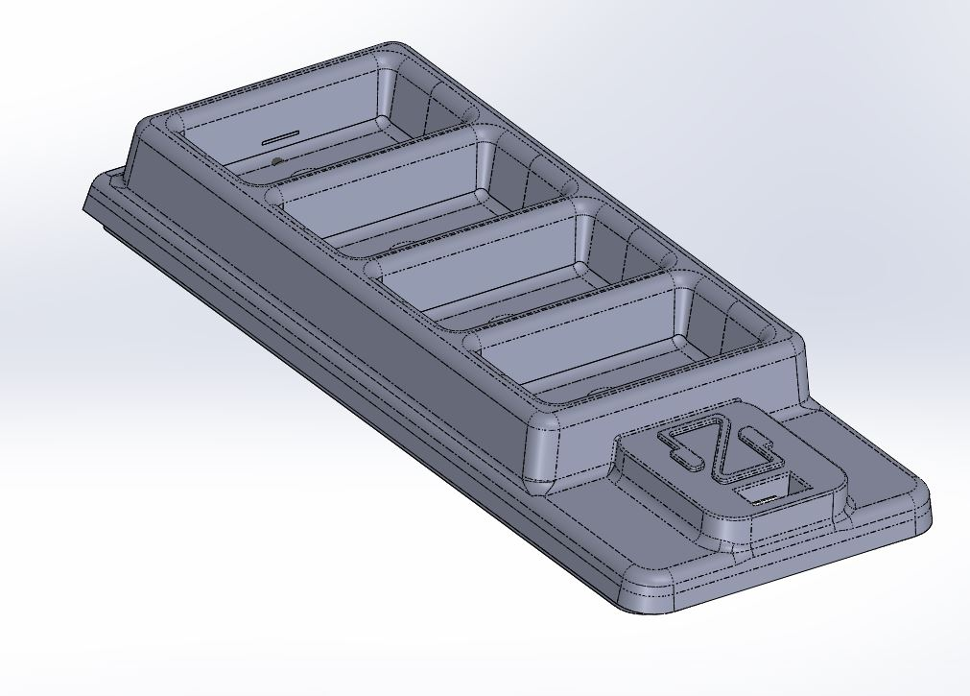
ZR2-PCK-TRA
Sub-Assembly
Overall Finish: Based On Polystyrene

Slide 31
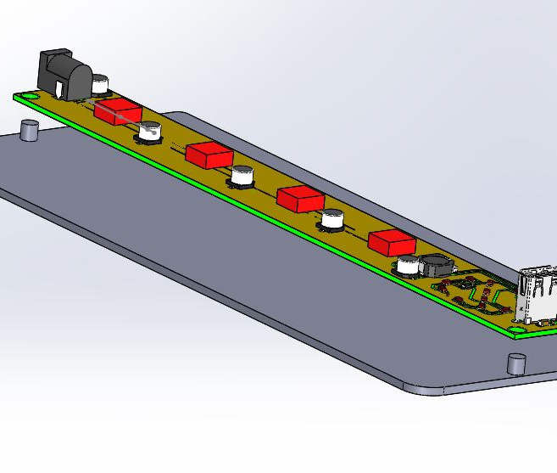
Sub -Assm # | Assm #
ZR2-PCK-TRA | ZR2-PCK-TRA-E1-ASSM3
 | ZR2-PCK-TRA-E1-ASSM4
ZR2-ASSM2 | ZR2-ASSM2
Insert
Put PCB into bottom tray i.e.
ZR2-PCK-E1-PCB into ZR2-PCK-TRA-BOT
ZR2-PCK-E1-PCB
ZR2-PCK-TRA-BOT
Note: PCB is not dimensioned exactly

Slide 32
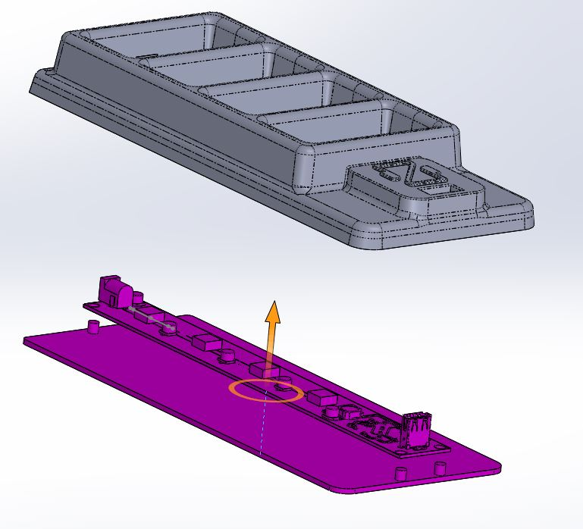
Sub -Assm # | Assm #
ZR2-PCK-TRA | ZR2-PCK-TRA-E1-ASSM3
 | ZR2-PCK-TRA-E1-ASSM4
ZR2-ASSM2 | ZR2-ASSM2
Insert
Insert Tray 1 onto previous assembly i.e.
ZR2-PCK-TRA-TOP onto ZR2-PCK-E1-ASSM3
ZR2-PCK-TRA-TOP
ZR2-PCK-E1-ASSM3

Slide 33
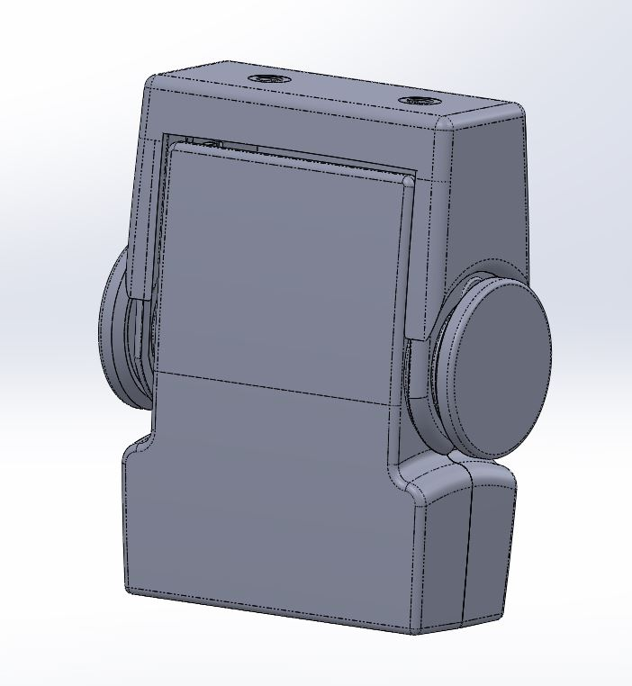
ZR2-ASSM2
Final Motor Module Assembly

Slide 34
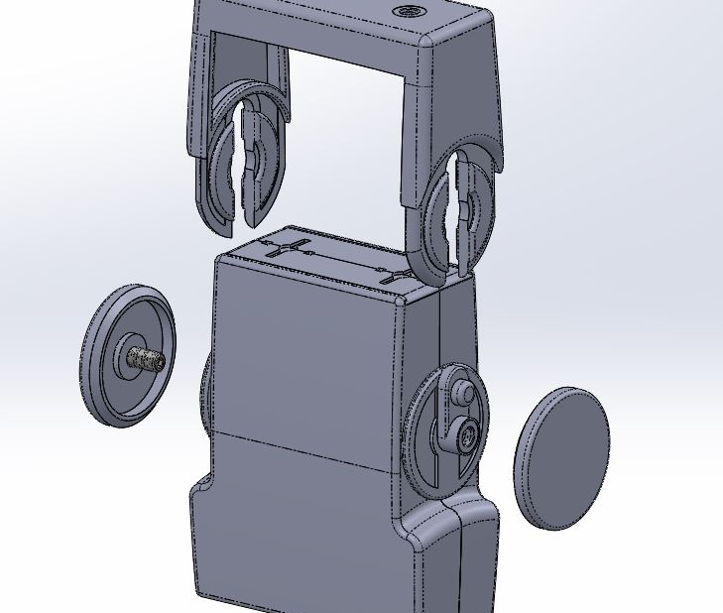
Sub -Assm # | Assm #
ZR2-PCK-TRA | ZR2-PCK-TRA-E1-ASSM3
 | ZR2-PCK-TRA-E1-ASSM4
ZR2-ASSM2 | ZR2-ASSM2
Slide ZR2-MMD-HNG-ASSM1 to position as shown and screw 2 ZR2-MMD-RPS-ASSM1 to Module Assembly ZR2-MMD-ASSM5
ZR2-MMD-HNG-ASSM1
ZR2-MMD-ASSM5
ZR2-MMD-RPS-ASSM1
ZR2-MMD-RPS-ASSM1

